Slide 1

Traffic Sign Recognition for Advanced Driver Assistance System (ADAS) using Deep Learning techniques
MAJOR PROJECT

Slide 2

MEMBERS OF THIS PROJECT
Sharika Anjum Mondal
Prithivi Guha
Koustav Pal

Slide 3

CONTENTS
Abstract
Introduction
Workflow – 1
Model Evaluation
Workflow – 2
Results
Limitations
Applications
Future Work
Conclusion
This Photo by Unknown Author is licensed under CC BY

Slide 4

The traffic sign recognition system (TSRS) is an important component of an intelligent transportation system (ITS). Being able to interpret traffic signs properly and efficiently can increase driving safety. This project proposes a traffic sign identification approach based on deep learning, which primarily targets at the detection and classification of traffic signs while being trained on a traffic sign benchmark dataset. A traffic sign recognition and identification approach based on image processing is proposed, which is integrated with a convolutional neural network (CNN) to classify traffic signs. TensorFlow is utilized to implement CNN. We have 99.4% accuracy in identifying.
ABSTRACT

Slide 5

INTRODUCTION
The global self-driving cars market size is projected to grow from 20.3 million units in 2021 to 62.4 million units by 2030. Thus, safety features are an important prerequisite for automotive customers across the world.
In the world of Artificial Intelligence and advancement in technologies, many researchers and big companies like Tesla, Uber, Google, Mercedes-Benz, Toyota, Ford, Audi, etc. are working on autonomous vehicles and self-driving cars. So, for achieving accuracy in this technology, the vehicles should be able to interpret traffic signs and make decisions accordingly.
There are several different types of traffic signs like speed limits, no entry, traffic signals, turn left or right, children crossing, no passing of heavy vehicles, etc. Traffic signs classification is the process of identifying which class a traffic sign belongs to.
Thus in this project, we will build a deep neural network model that can classify traffic signs present in the image into different categories. With this model, we are able to read and understand traffic signs which are a very important task for all autonomous vehicles.

Slide 6

DATA COLLECTION
Benchmark dataset in traffic sign recognition – GTSRB
The dataset contains more than 50,000 images of different traffic signs.
It is further classified into 43 different classes.
It is quite varying, some of the classes have many images while some classes have few images.
The size of the dataset is around 300 MB.
The dataset has a train folder which contains images inside each class.
A test folder which we will use for blind testing our model.

Slide 7
IMPORTING THE PRE-REQUISITES
Keras
Sequential
Dense
cv2
matplotlib
Pickle
Adam
Categorical
Dropout
Os
Pandas
Numpy
Random
Sklearn – train_test_split
Others
Flatten
Conv2D
MaxPooling2D
ImageDataGenerator

Slide 8
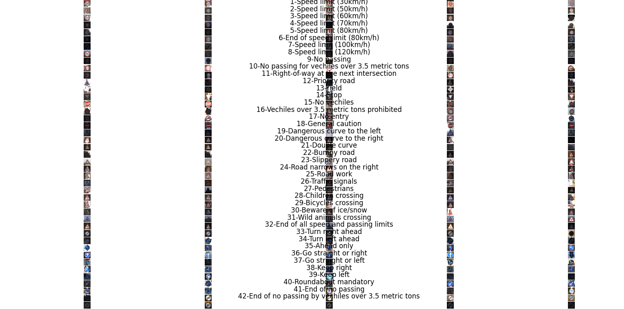
IMPORTING THE IMAGES
Getting the path of the main folder
Getting inside each classes (sub folder) and keeping a count on them as well
Reading each image and appending them in a folder with their proper class no.
Finally dividing the data in training, testing and validating set.

Slide 9

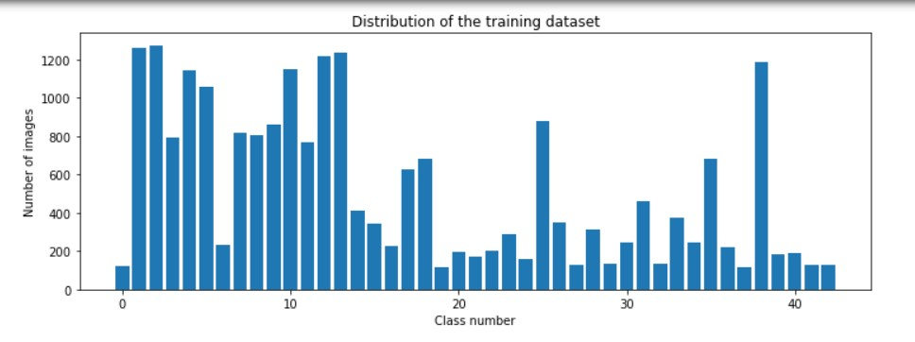
DATA VISUALIZATION

Slide 10
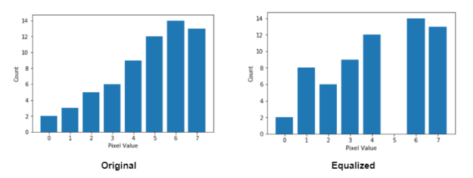
IMAGE PROCESSING &
IMAGE AUGMENTATION
Get the image
Grayscale
Equalize
Normalize the image
Image augmentation – width & height shift, sheer angle, zoom range, rotation range
Store the images

Slide 11
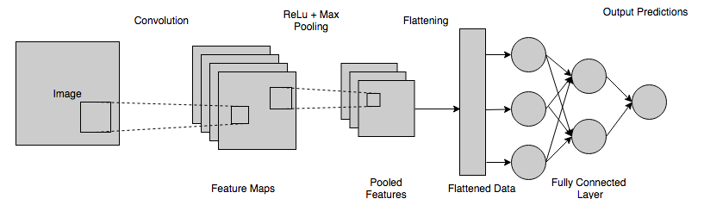
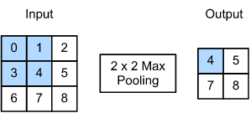


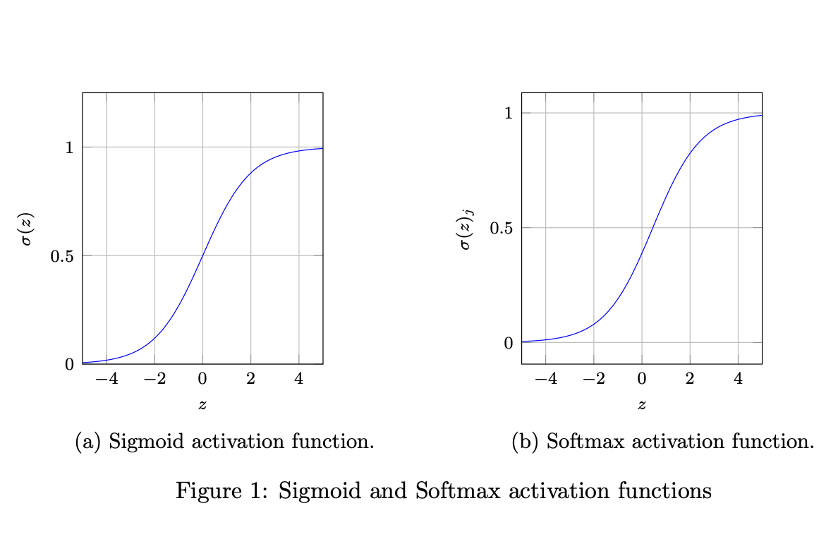

MODEL BUILDING

Slide 12
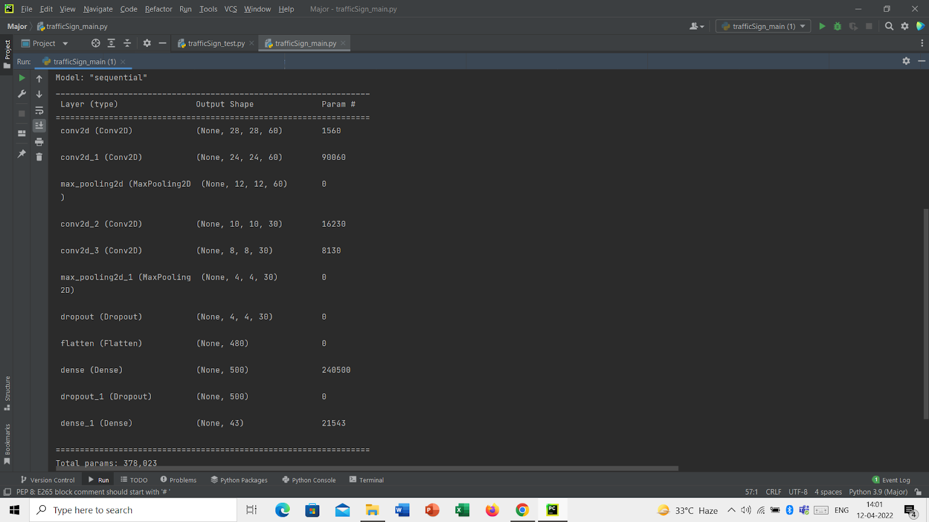
TRAINING
Training time = 5hrs 30mins approx.

Slide 13
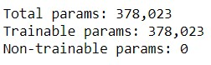
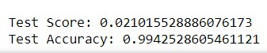
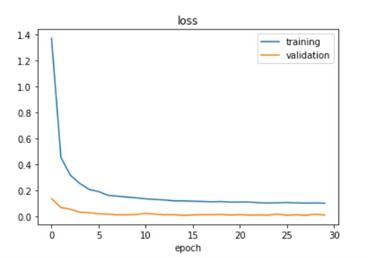
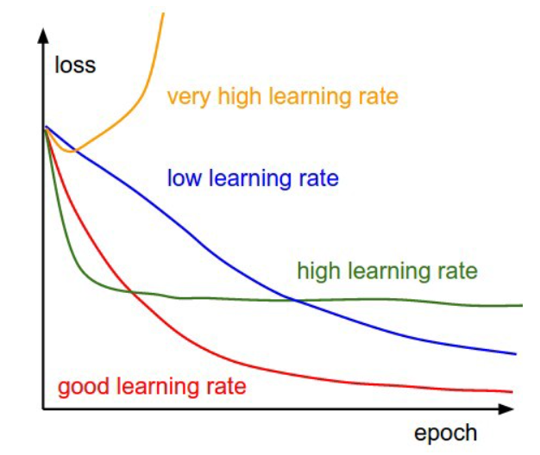
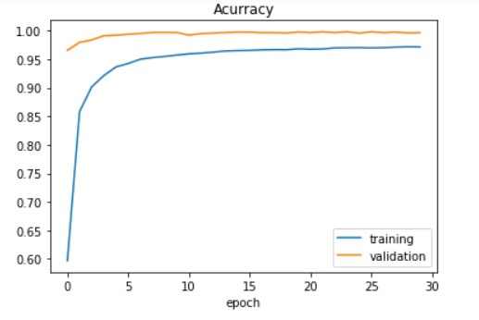
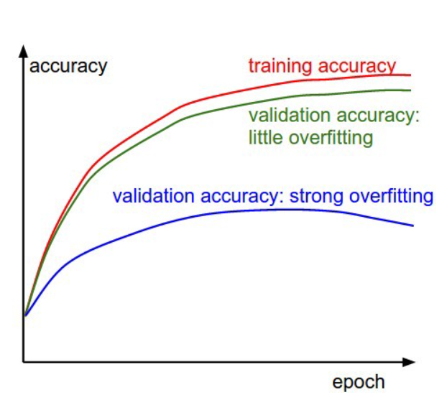
MODEL EVALUATION

Slide 14
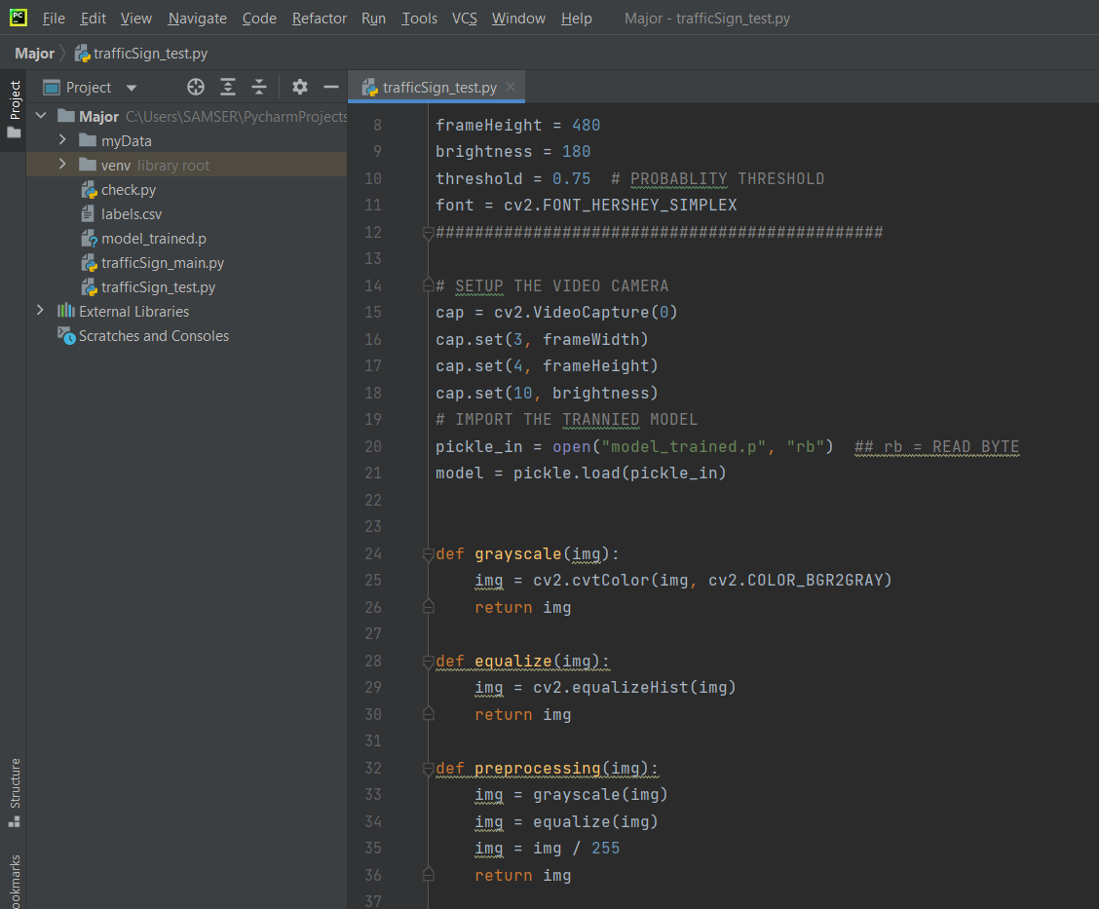
SETTING THE WEB CAM & TESTING

Slide 15
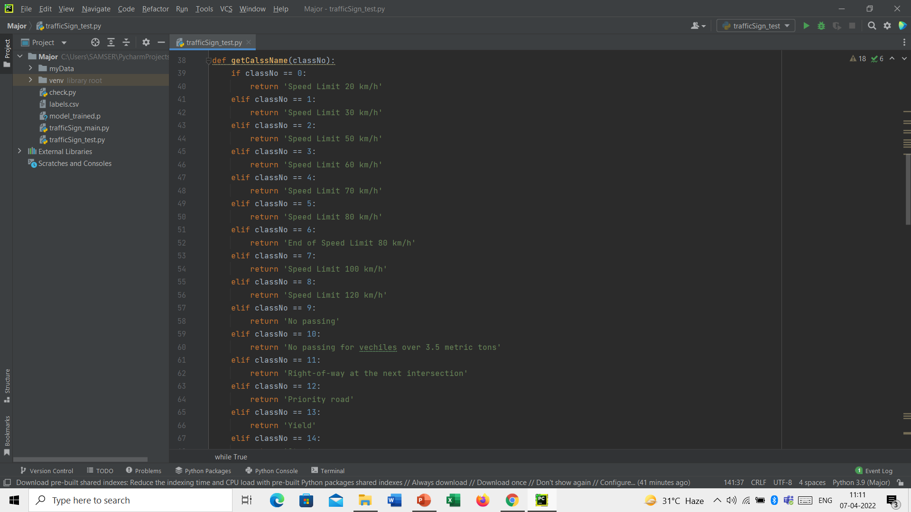
SETTING THE WEB CAM & TESTING

Slide 16
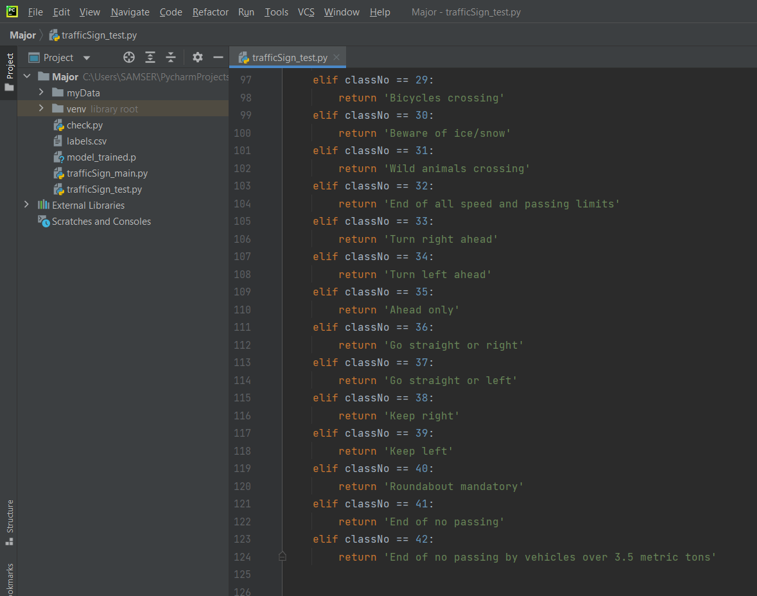
SETTING THE WEB CAM & TESTING

Slide 17
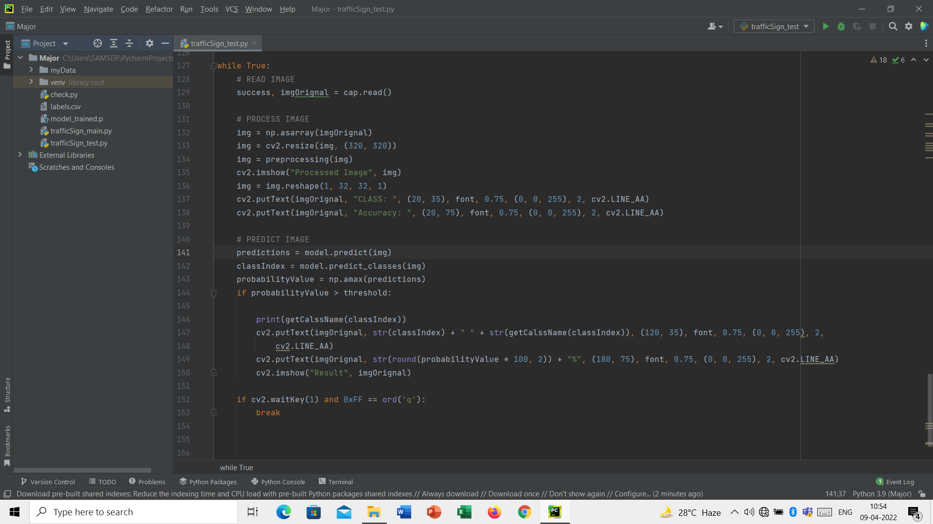
SETTING THE WEB CAM & TESTING

Slide 18
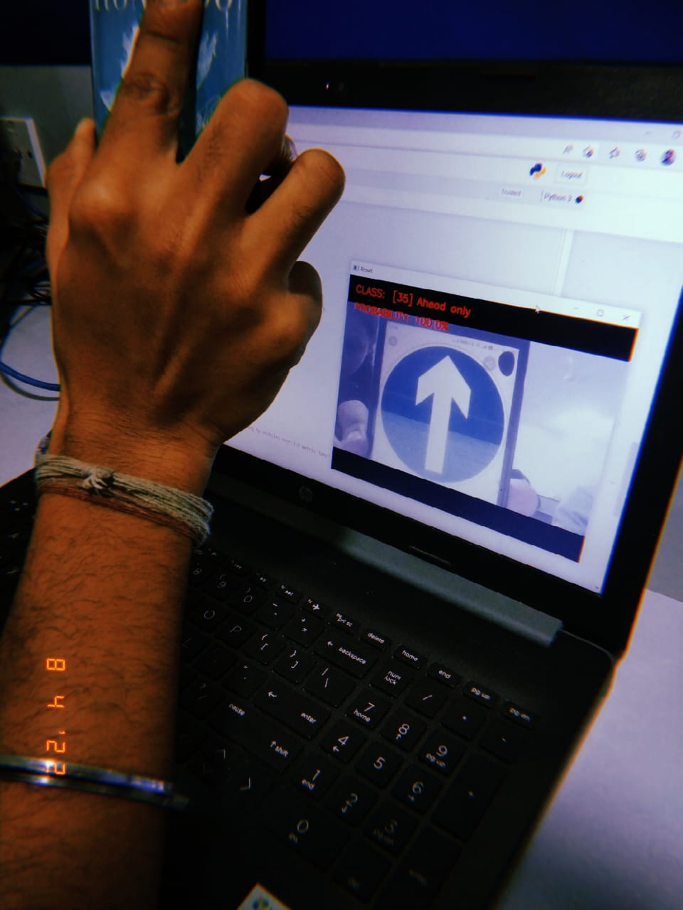
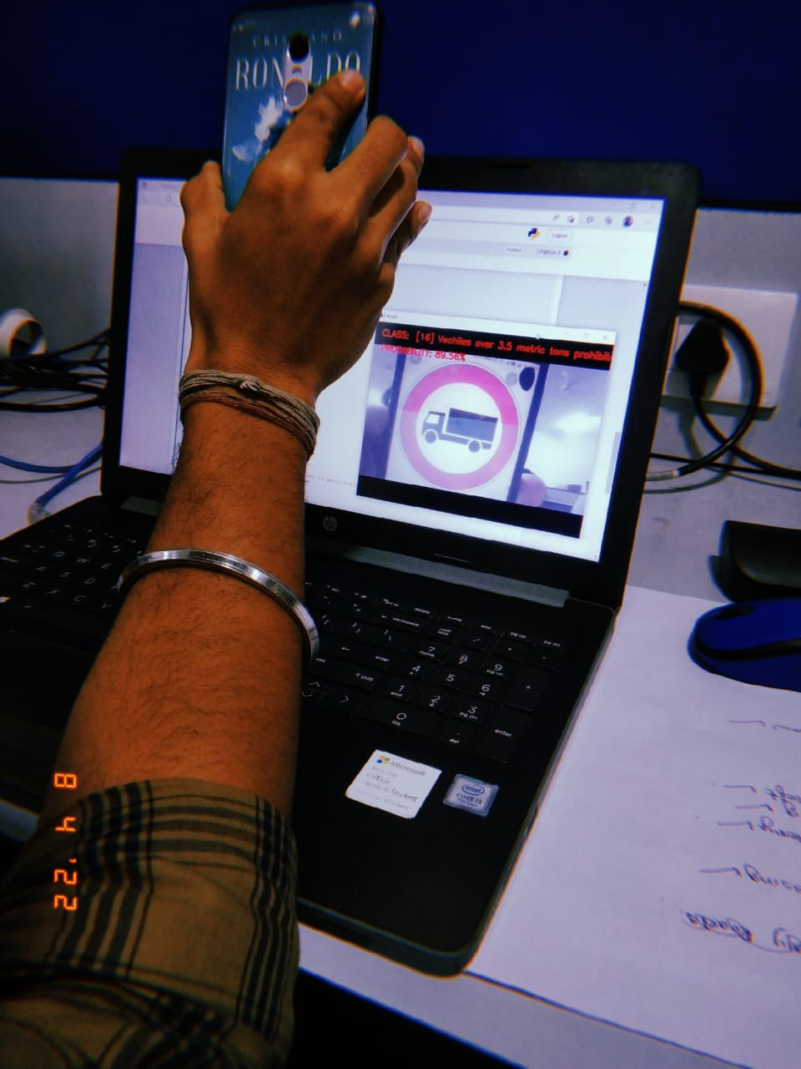
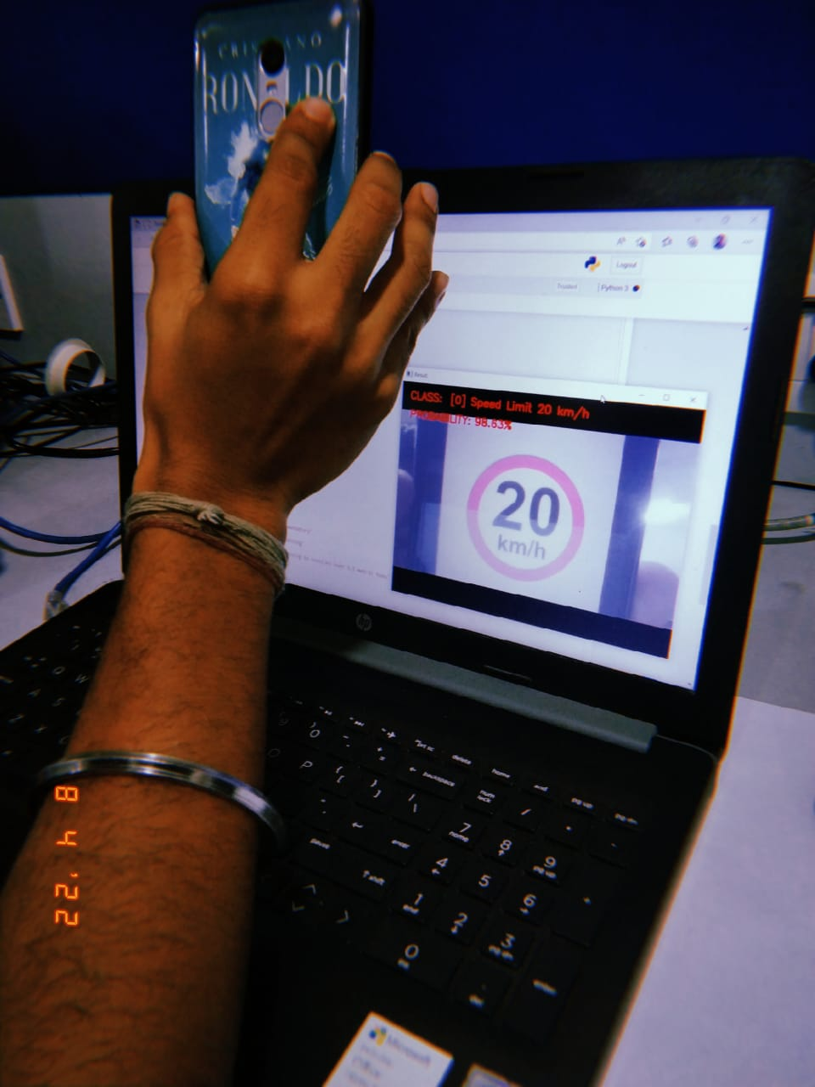
RESULTS
Detected class – Ahead only
Accuracy – 100%
Detected class – Vehicles over 3.5 metric tones prohibited
Accuracy – 89.56%
Detected class – Speed limit 20km/h
Accuracy – 98.63%

Slide 19

LIMITATIONS
The model fluctuates to detect the classes as the pictures are put in-front of the camera via hands which are prone to error with even a little modification in the hand orientation changes.
The model fails to capture pose, view, orientation of the images because of the intrinsic inability of max pooling layer.
Image processing should be done properly to detect and focus the sign boards properly and to read the images which are hazy.

Slide 20

APPLICATIONS
Provide drivers with traffic sign information, and regulate driver operations in all vehicles if installed.
Helpful for self-driving cars.
Helpful for people inside the car with visual impairment as it is an audio enabled system.
Ensures road safety.

Slide 21

Future Work
The model fails to capture pose, view, orientation of the images because of the intrinsic inability of max pooling layer, so this area needs to be worked on.
Image processing should be done properly and also a good IP camera required to detect and focus the sign boards properly and to read the images which are hazy.

Slide 22

This project considers a classification algorithm implementation for the traffic sign recognition problem. The suggested approach for traffic sign classification, when combined with image processing stages, yields extremely good results: 99.4 percent of correctly identified photos. The TensorFlow framework is used to implement the proposed classification method. The created approach was tested on a device equipped with an Intel Core i3 7th Gen Processor. In future, we intend to train the CNN to take into account more traffic sign classifications as well as probable severe weather circumstances.

Slide 23


